Slide 1
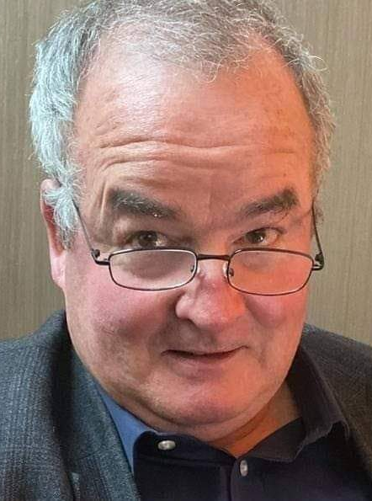
Web 7.0
DIDComm Notation
Template
Version 0.3
Michael Herman
Self-Sovereign Blockchain Architect, Developer, and Futurist
Trusted Digital Web
Hyperonomy Digital Identity Lab
Parallelspace Corporation
Bindloss, Alberta, Canada / Chelem, MEXICO
Copyright (c) 2022-2023 Michael Herman (Alberta, Canada) - Creative Commons Attribution-ShareAlike 4.0 International Public License

Slide 2

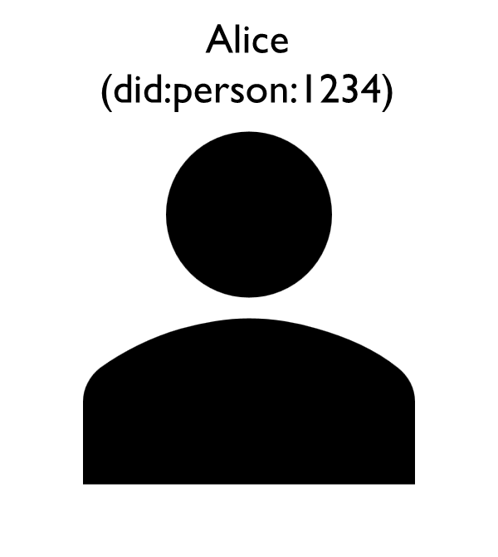
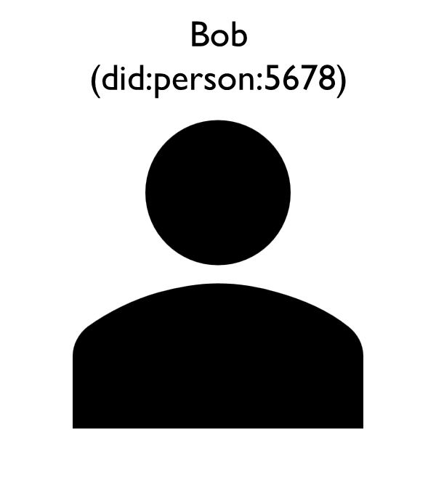
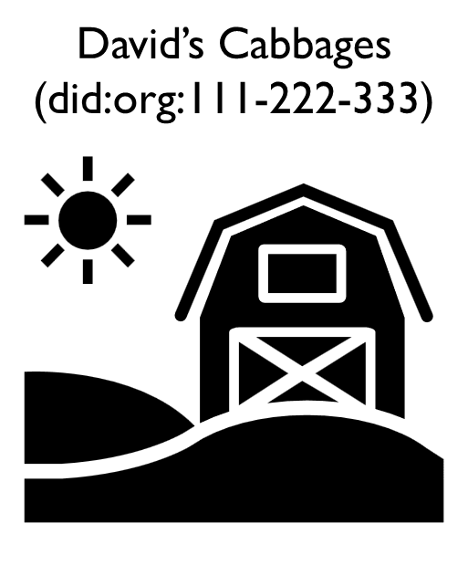
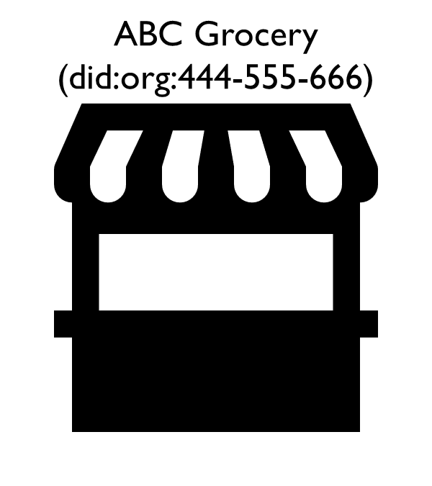

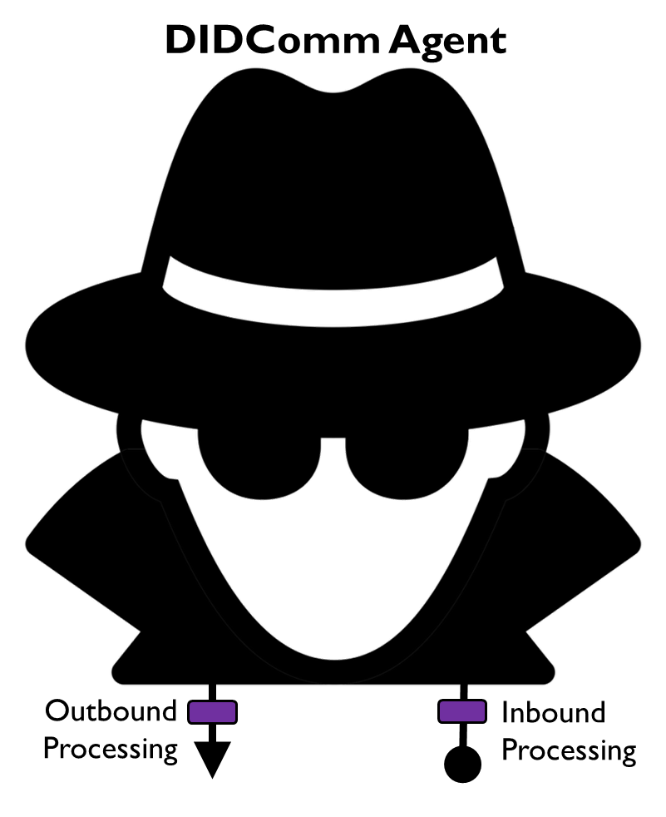
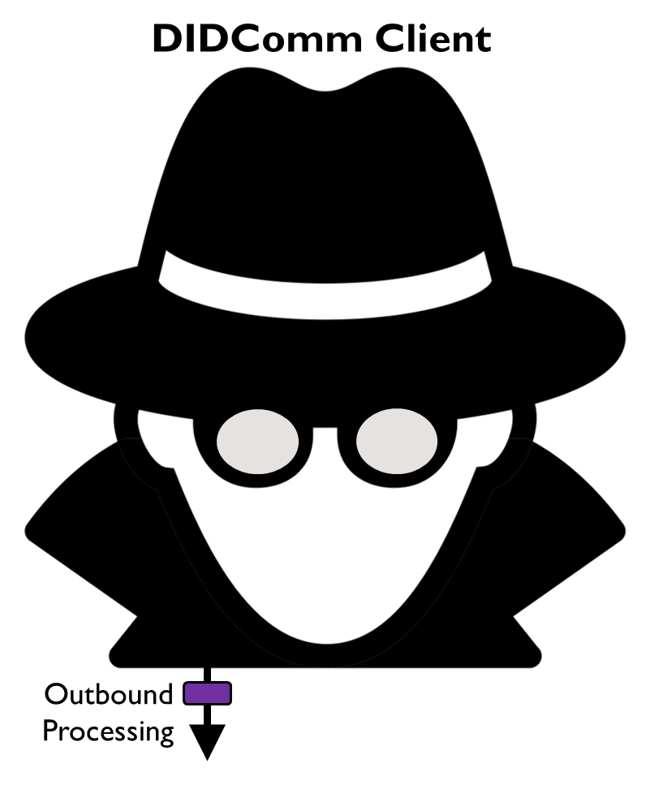
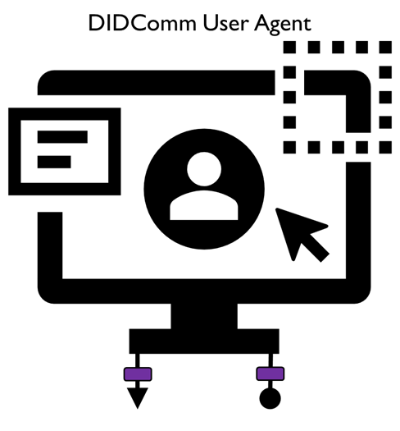
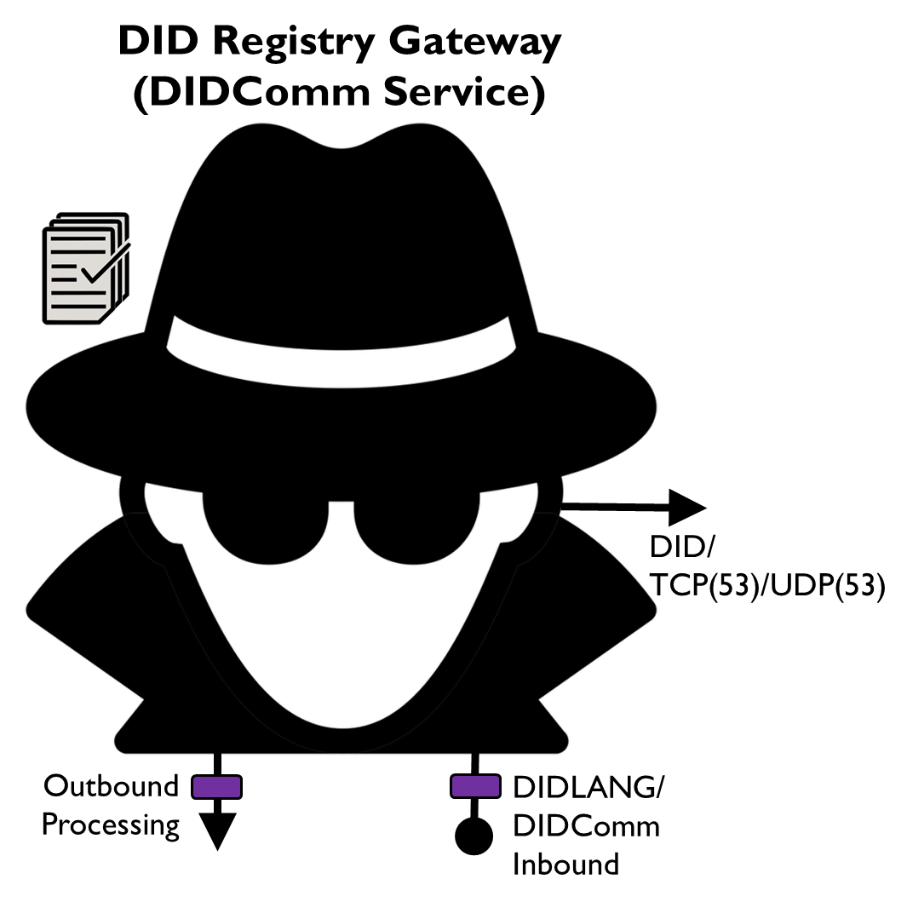
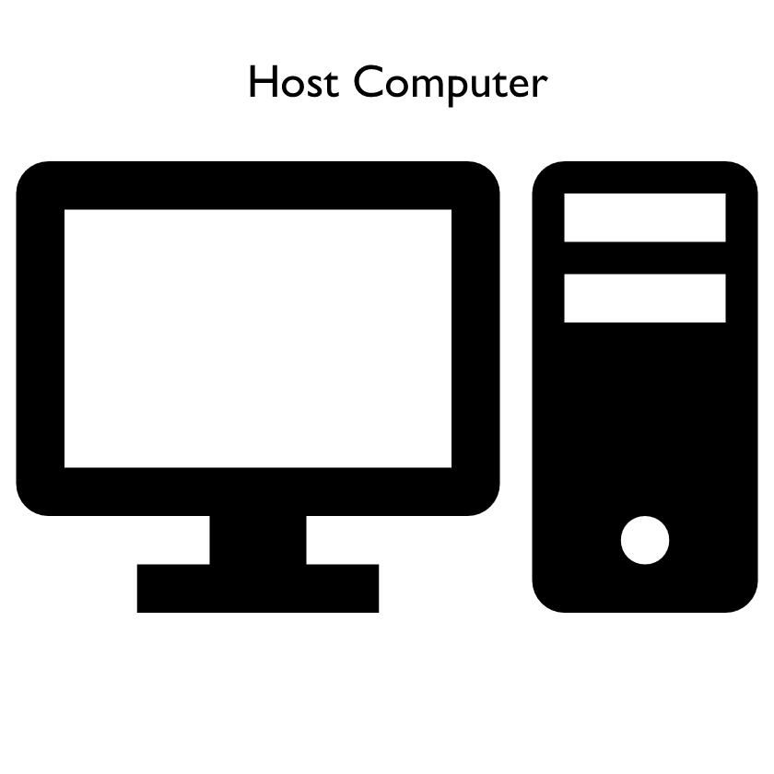
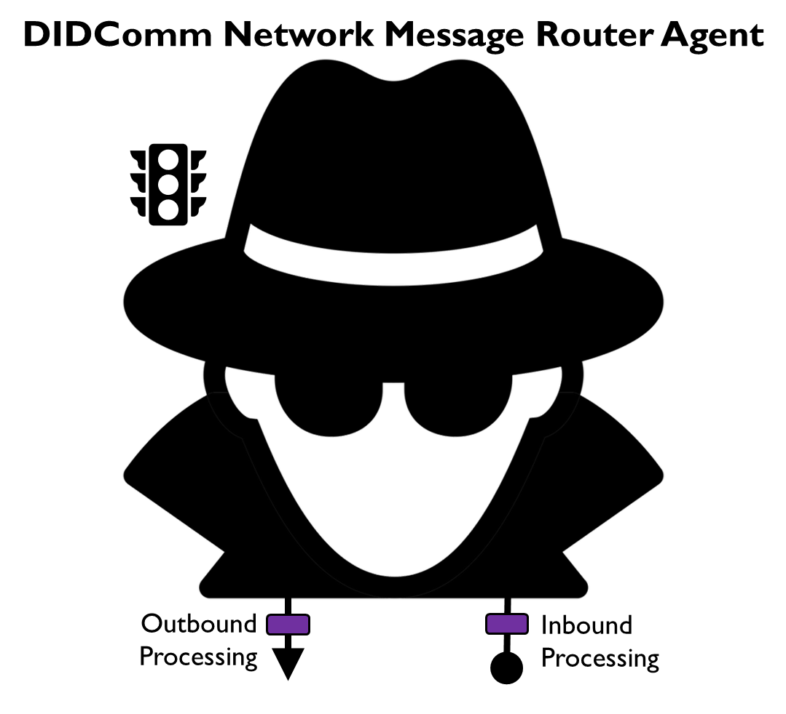
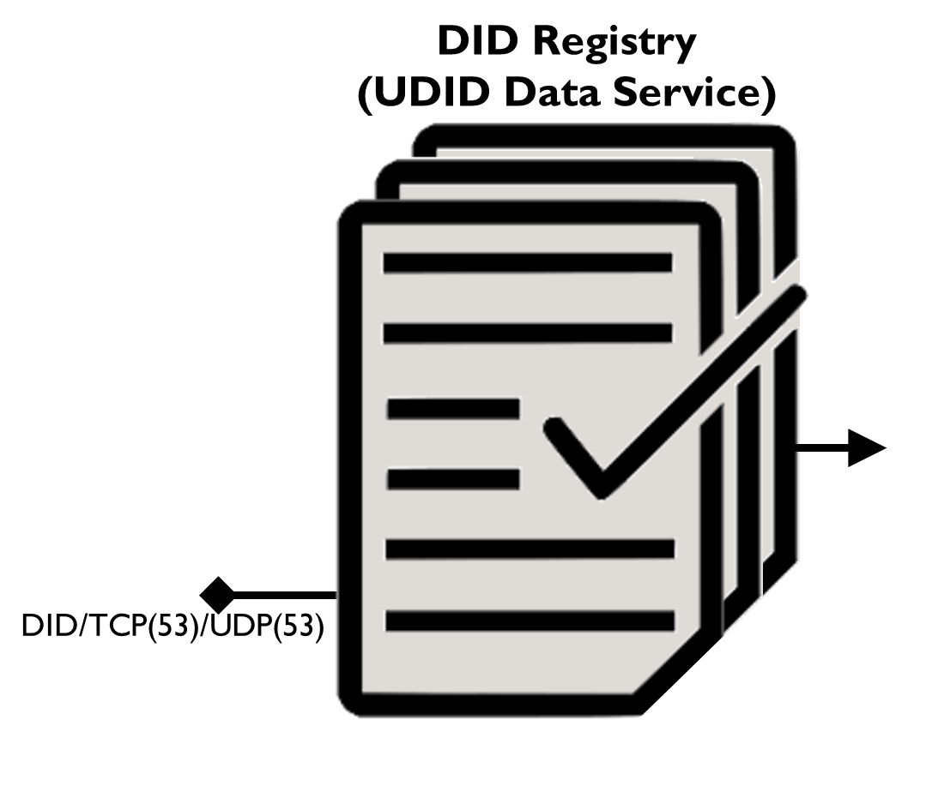


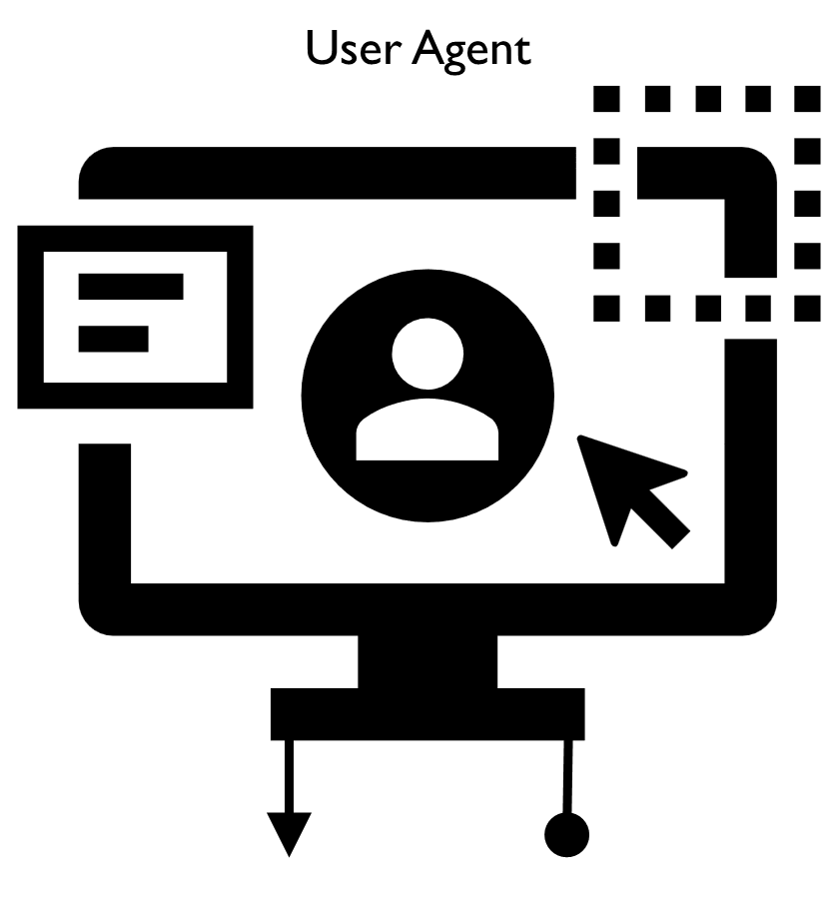
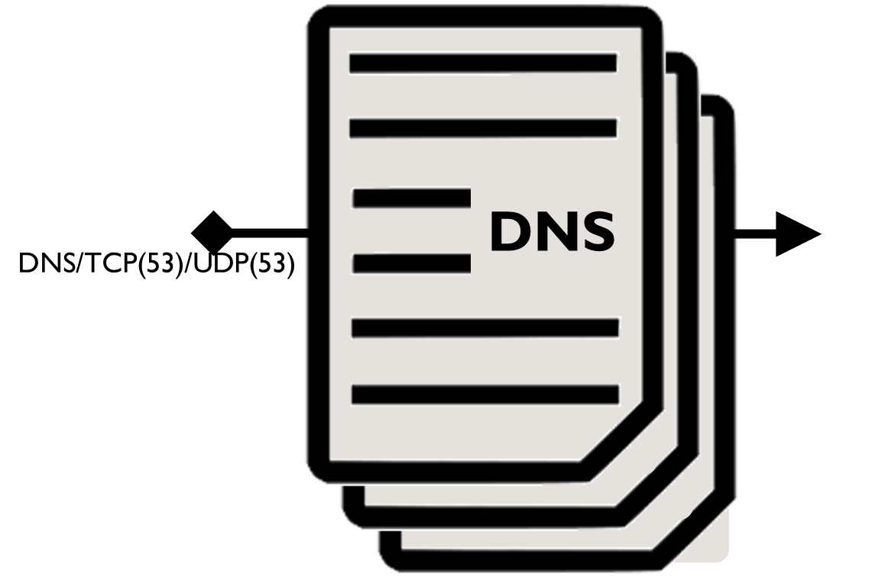
Thrift Bank
(did:org:777-888-999)
DIDComm Message Attachment
(Business Card Verifiable Credential)
Alice’s Agent
http://example.com:8080
(http://128.0.0.1:8080)
Bob’s Agent
http://example.com:8085
(http://128.0.0.1:8085)
David’s Cabbages Agent
http://example.com:8090
(http://128.0.0.1:8090)
ABC Grocery Agent
http://example.com:8095
(http://128.0.0.1:8095)
Thrift Bank Agent
http://example.com:8100
(http://128.0.0.1:8100)
DIDComm Message
(Plain Text) Message
DIDLANG/DNS Query

